Slide 1

Total Joint Discharge Instructions
Molly Sieffert BSN, RN
Orthopedic Nurse Navigator

Slide 2
This information is a review of the content in your Hip/Knee Replacement Guide that you received at your preadmission testing appointment. Please keep the guidebook handy at home, for easy reference as you recover.
Please watch this presentation and ask your nurse or call your Nurse Navigator if you have any questions.

Slide 3
Pain Management
Take Tylenol 1000 mg every 8 hours, and your opioid pain medication as needed. Check your discharge instructions to see if you are allowed take ibuprofen also.
Side effects of the opioid pain medication are nausea, constipation and drowsiness
It is important that you take your pain medication as prescribed- do not take additional medication unless your surgeon allows
Use ice/cold therapy to help control pain and swelling
If your pain medicine isn’t effective in controlling your pain, contact your surgeon

Slide 4
Swelling/Bruising
Swelling is normal and can continue for a few months after surgery
Bruising is also very common
Elevating your leg above the level of the heart is important- try to elevate 3-4 times per day for 30 min each time
Make sure you are using cold therapy e.g. cold machine/gel packs/ice to help reduce the swelling

Slide 5
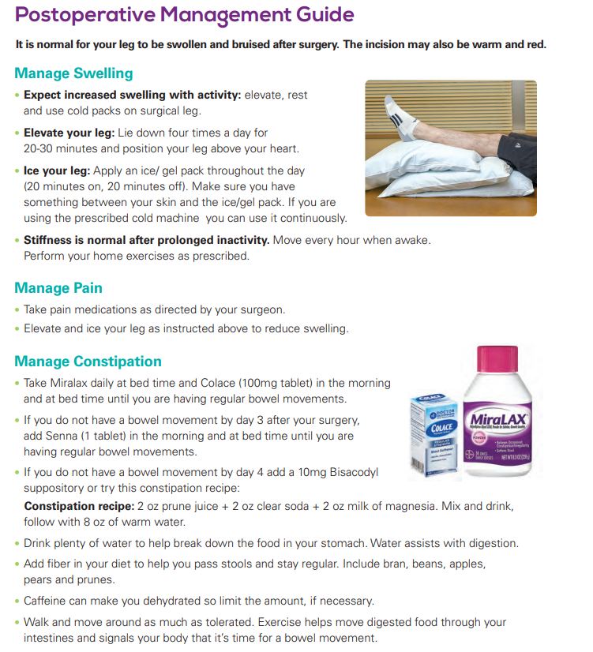
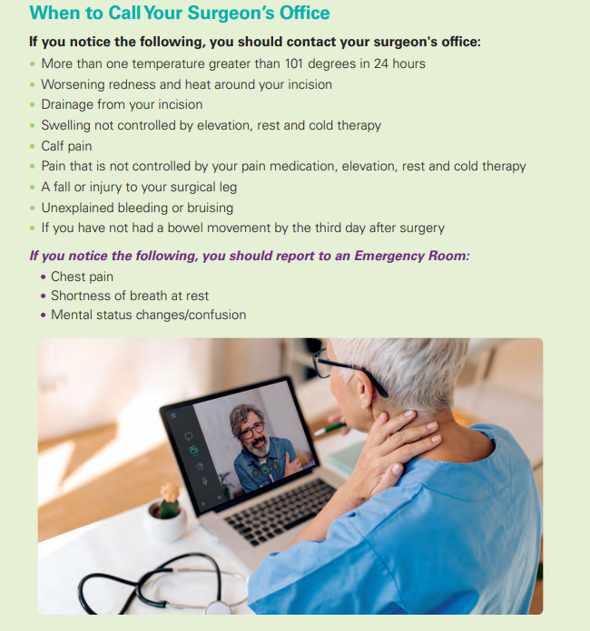
Post Operative Guide

Slide 6
Nausea Prevention
You may experience nausea after your surgery due to the anesthesia, pain medication and constipation.
To prevent nausea:
Don’t take your pain medicine on an empty stomach-always eat food with your pain medication.
If you are nauseated, eat small frequent meals and drink plenty of water
Contact your surgeon if you continue to have nausea

Slide 7
Other common complaints after surgery
Frequent urination-improves over time
Insomnia- you might only sleep 2-3 hours at a time for the first few weeks. Some people find sleeping in recliners comfortable when they first get home. Knee replacements- try to keep your knee straight when sleeping
Decreased appetite- eat small frequent meals

Slide 8
Signs and Symptoms of a DVT (Deep Vein Thrombosis)
Signs of a DVT (blood clot in the leg) are:
Swelling in the thigh, calf or ankle that doesn’t go down after elevating your leg
You might also have unusual pain, heat or tenderness in calf, thigh, groin or back of the knee
CALL YOUR SURGEONS OFFICE IF YOU THINK YOU HAVE A DVT

Slide 9
Signs and symptoms of a PE(Pulmonary Embolism)
Signs of a PE (blood clot in the lungs) are:
Shortness of breath
Chest pain
Coughing up blood
Rapid heart rate
Confusion
CALL 911 IF YOU HAVE SYMPTOMS OF A PE

Slide 10
Blood Clot Prevention
Ankle pump/circulation exercises
Get up for a short walk at least every hour during waking hours
Take your anticoagulant medication as prescribed
A possible side effect of anticoagulants is excessive bleeding, if you notice any severe or recurrent bleeding call 911
You should also seek immediate medical attention if you:
Are involved in a major accident
Experience a blow to the head
Are unable to stop any bleeding

Slide 11
Incision Care
You should remove your dressing 7 days after surgery
You may shower with the dressing on and after it is removed. If you had a knee replacement- wait until your nerve block has been removed.
Use your Dynahex/Hibiclens soap until gone then use antibacterial soap like Dial until you are healed
Do not put lotions or creams on your incision
Do not go in a tub bath, hot tub, pool or lake etc until your incision is completely healed (all scabs are gone, openings closed and no drainage from incision)- usually 6 weeks

Slide 12
Infection Prevention
Do not touch your incision until it is healed
Wash your hands well during your recovery to prevent infection
Clean your cell phone and other items like TV remotes frequently
Do not put lotions, creams, ointments or sprays on your incision until it is well healed and scarred
If you develop a cut or puncture wound anywhere on your body, clean the area thoroughly. Watch carefully for redness, drainage, a fever or other signs of infection
Tell your primary care provider and your dentist that you have had a joint replacement
Do not have a routine dental check-up or cleaning for at least 3 months following your joint replacement, then you will also need antibiotics before dental visits

Slide 13
Mobility /Exercises
Continue following your home exercise program given to you by your physical therapist. This is also in your Hip/Knee Replacement Guide
Get up for a short walk every hour during the day
Your activity level should increase every day as you progress in your recovery, you may use a pedometer/activity tracker to track your steps

Slide 14
Contact your Orthopedic Surgeon if:
You have more than one temperature greater than 101 degrees in 24 hours or chills with a fever
You have bleeding from your incision that soaks your dressing
Worsening redness and heat around your incision
You have an increase in drainage or a bad smell from the incision
You develop an open area on your incision
You are having pain that you can’t control when you are taking your pain medications as directed
You develop numbness or tingling in the surgical foot or leg

Slide 15
Contact your Orthopedic Surgeon if:
You fall
You develop any symptoms of a blood clot in your leg such as swelling in the thigh, calf or ankle that doesn’t go down after elevating your leg; or pain, heat or tenderness in calf, thigh, groin or back of the knee
Call 911 if you develop chest pain or sudden shortness of breath or any other symptoms of a blood clot in your lung

Slide 16
Thank you for your attention today. If you have any questions about this information, talk with your nurse or call your Nurse Navigator or surgeon.
The education is available at any time on our website for you or your family to view and review again.
Thank you,
Molly
Orthopedic Nurse Navigator
734-712-2392

