Slide 1
Patient Guide to Continuous Nerve Block Catheter with Home Pain Pump
Orthopedic Surgeries
Trinity Health Ann Arbor, Brighton, and Livingston

Slide 2
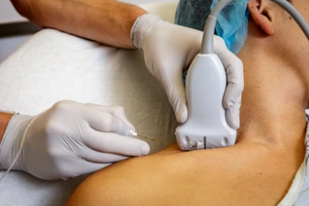
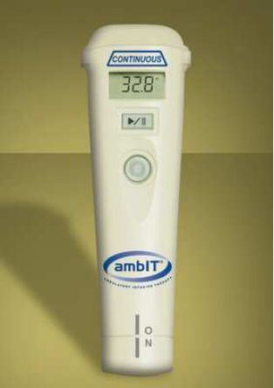
General Information
Nerve blocks can be used to help control some of your pain after surgery.
Because of the anatomy of nerves, a nerve block may not take away all your pain.
You may have areas of numbness and you may not be able to move your fingers or toes while the nerve block is in effect.
However, they are very helpful as an additional way to provide pain relief during the first few days after your surgery.

Slide 3
Nerve Block Catheter – What to Expect
On the day of surgery:
The anesthesiologist will perform a nerve block and leave in place a catheter. This is done in pre-op before surgery.
This tiny tube (catheter) is connected to a pump that will deliver numbing medication around the nerves near your surgery site.
While you are getting ready for surgery, our educators will meet with your caregiver in the waiting room to review the pump instructions.

Slide 4
Nerve Block Catheter – What to Expect
The pump is called an “AmbIT pump”
There is enough numbing medicine in the AmbIT pump to give you about 3-4 days' worth of additional pain control.
You will still be sent home with pain medicine prescribed by your surgeon.
It is OK to take your prescribed pain medicine and use the pain pump.
The pain nurses will review your instructions with you and your caregiver before you leave the hospital.

Slide 5
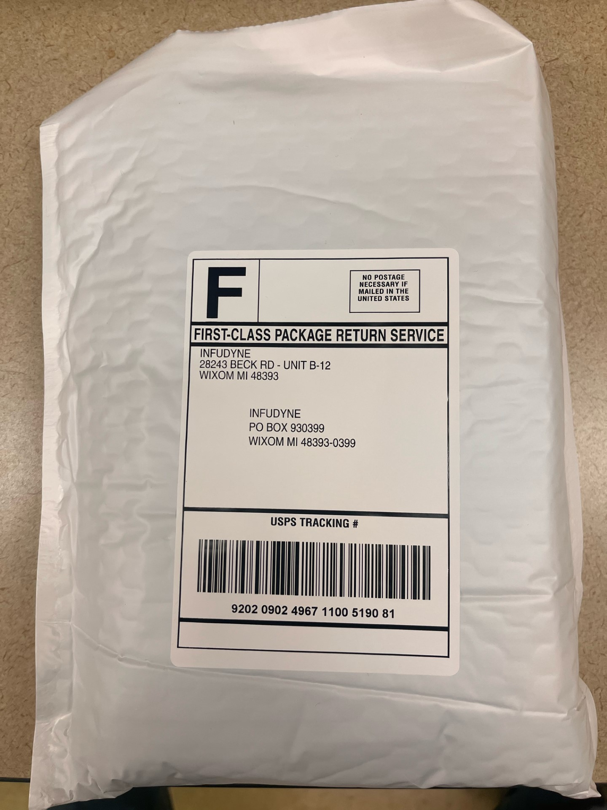
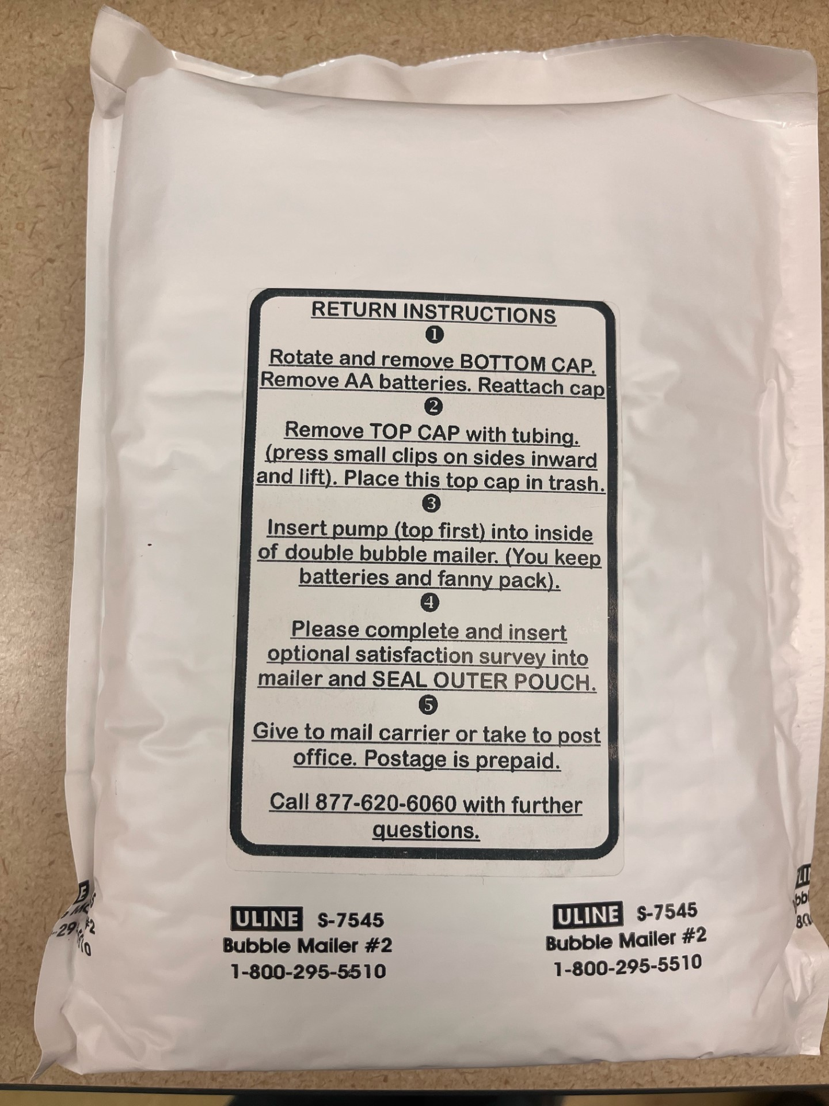
Nerve Block Catheter – What to Expect
You will receive a labeled return mailer on the day of your surgery.
This mailer is a white padded envelop.
It contains more instructions about the pump.
You will use it to return the pump to the vendor company.

Slide 6
Nerve Block Catheter – What to Expect
When the numbing medicine in the pump is completed and empty:
  You (or your caregiver) will remove the catheter (tiny tube) from your body.
      This is very quick, easy, and painless!
      Removal of the catheter does not require a visit to your surgeon's office.
  You will return the pump only to the vendor company.

Slide 7
Nerve Block Catheter – What to Expect
A phone number will be provided to you for any help you may need when it comes time to remove the catheter.
There is also an instructional video available to watch before and after your surgery:
  Link to video: AmbIT pump informational video

Slide 8
Nerve Block Placements:
This chart reviews where to expect your nerve block catheter to be based on what surgery you are having:
Surgery Type: | Catheter Location:
Knee | Mid – Upper Thigh
Ankle/Foot | Outside of your leg behind your knee
Shoulder | Side of neck
The next few slides contain photo examples of what the nerve blocks look like →

Slide 9
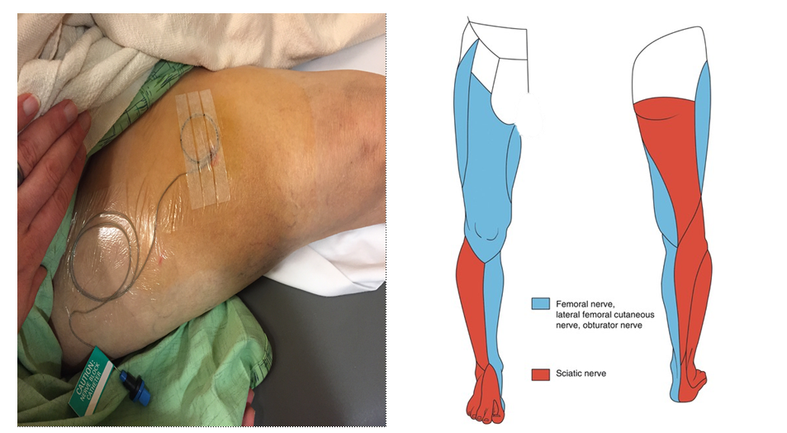
Knee Surgery –
The blue areas (inside of the knee) are where you should be numb after the block

Slide 10
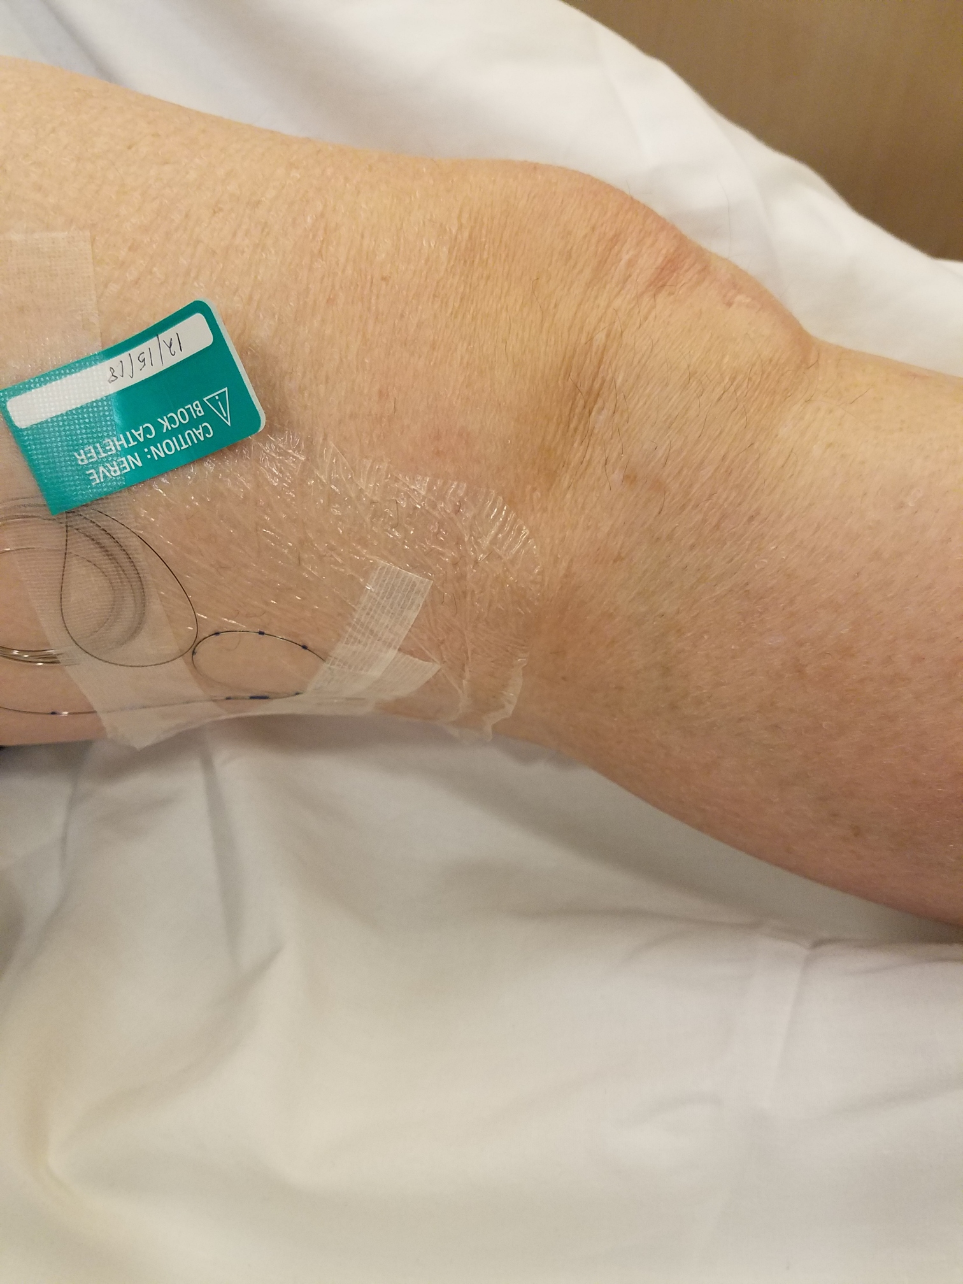
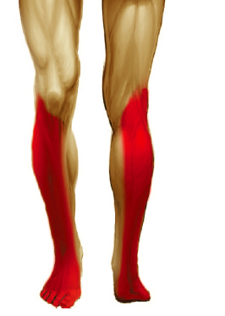
Ankle/Foot Surgery –
The red areas (outside of the leg) are where you should be numb after the block

Slide 11
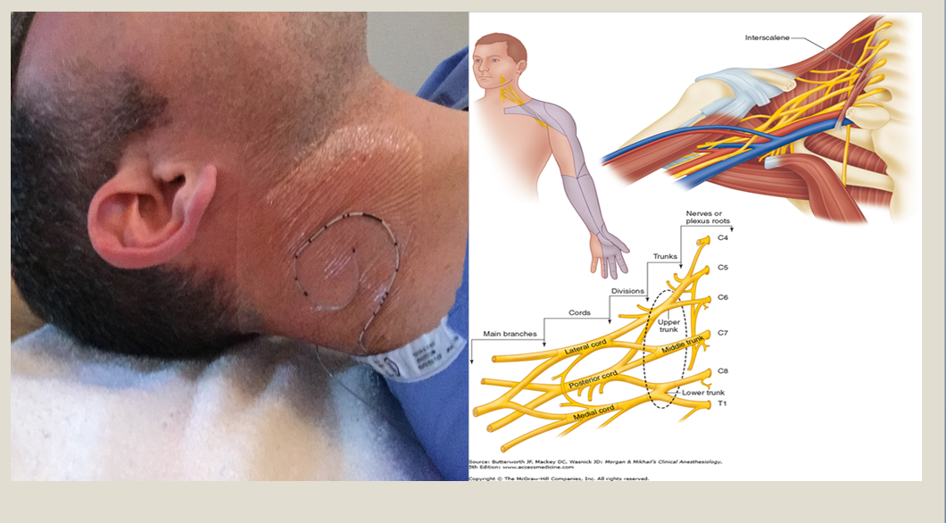
Shoulder Surgery –
The blue areas (top of shoulder and outside of arm) are where you should be numb after the block

Slide 12
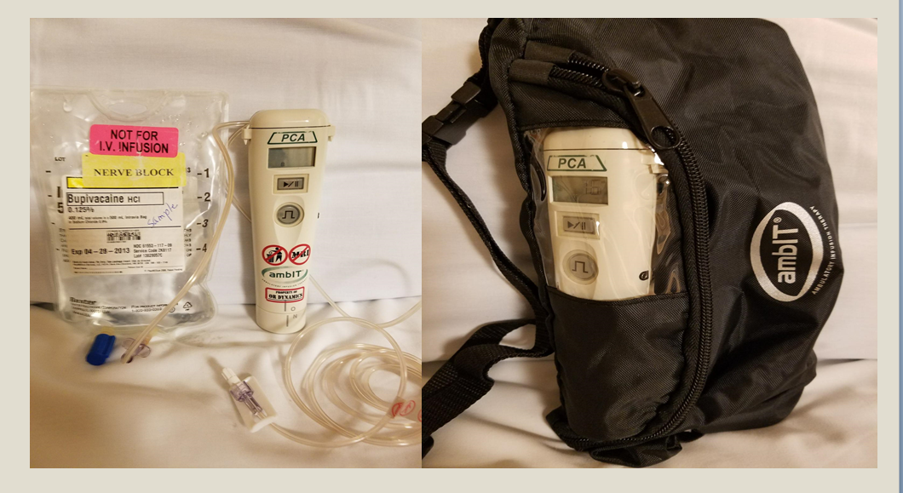
AmbIT Pump and Equipment:
You will receive:
The ambIT pump
Bag of numbing medication and tubing
Black nylon carrying bag
White labeled padded mailer with additional information

Slide 13
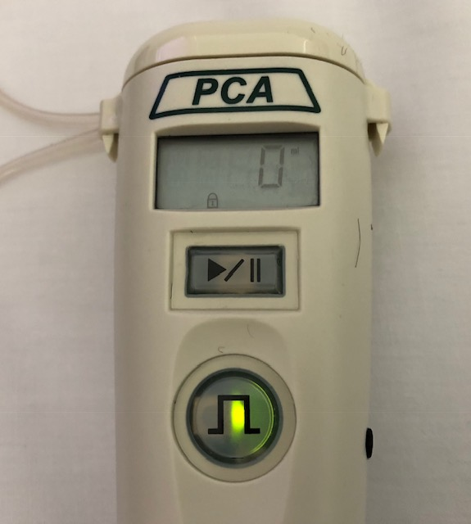
AmbIT Pump Functions – The Basics
Check that the numbers on the display screen are counting up
Check to make sure the circle button is flashing
If you see a number on the screen & the circle is flashing, the pump is on and running.
Display Screen
Play/Pause
Bolus/ “extra dose” button

Slide 14
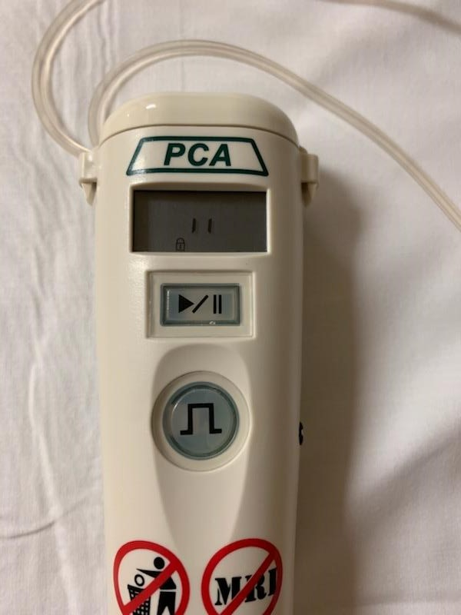
AmbIT Pump Functions – The Basics
Two vertical lines in the display screen of the pump indicate the pump has been paused.
Restart the pump by pressing the play/pause button
“ I I “
Hit this button to resume

Slide 15
AmbIT Pump Functions – The Basics
You will know the medicine is completed and it is time to remove when the display numbers are at:
Knee Surgery = 800
Ankle/Foot Surgery = 800
Shoulder Surgery = 600
Display Screen

Slide 16
Removing Your Nerve Block Catheter:
Follow the detailed instructions given on the day of surgery
Refer to the video link
Remove all tape covering your nerve block
Gently pull the catheter
Pull until the entire catheter is out and a blue tip is visible at the end

Slide 17
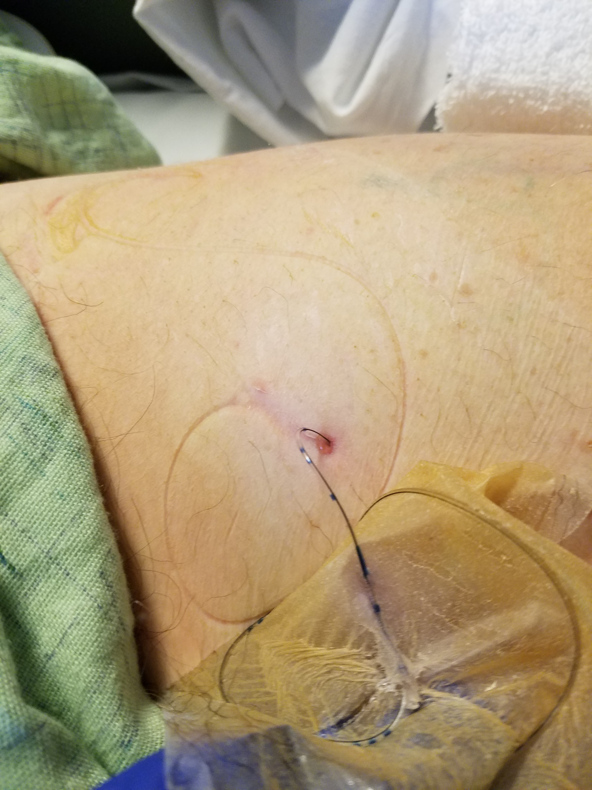
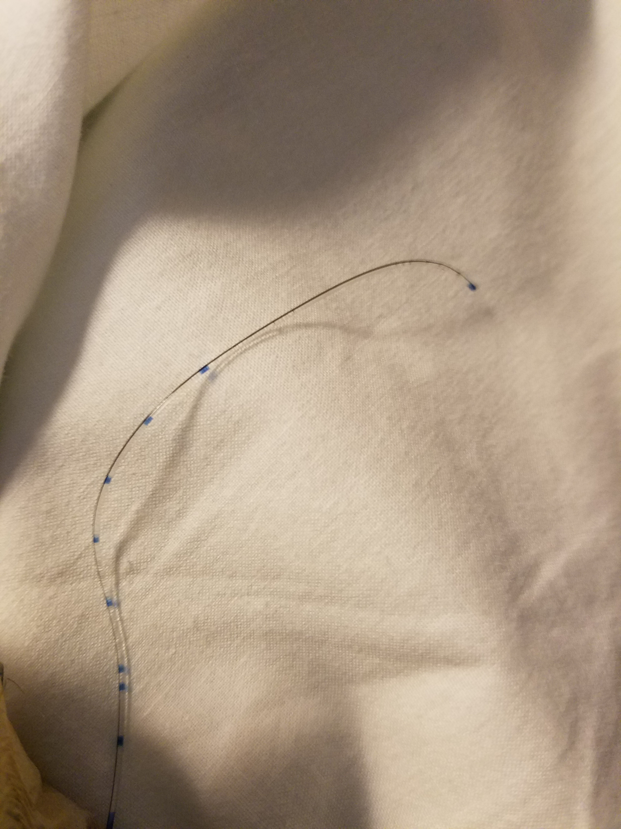
Removing Your Nerve Block Catheter:
Blue tip

Slide 18
Preparing Your Pump to Return Via Mail (USPS) :
Take apart the top portion of the pump (cassette)
  This un-clips from the pump
Discard the cassette, tubing, and empty bag of medicine
Take the batteries out of the bottom
Place the pump in the white envelope
Seal and drop off at the Post Office (USPS)

Slide 19
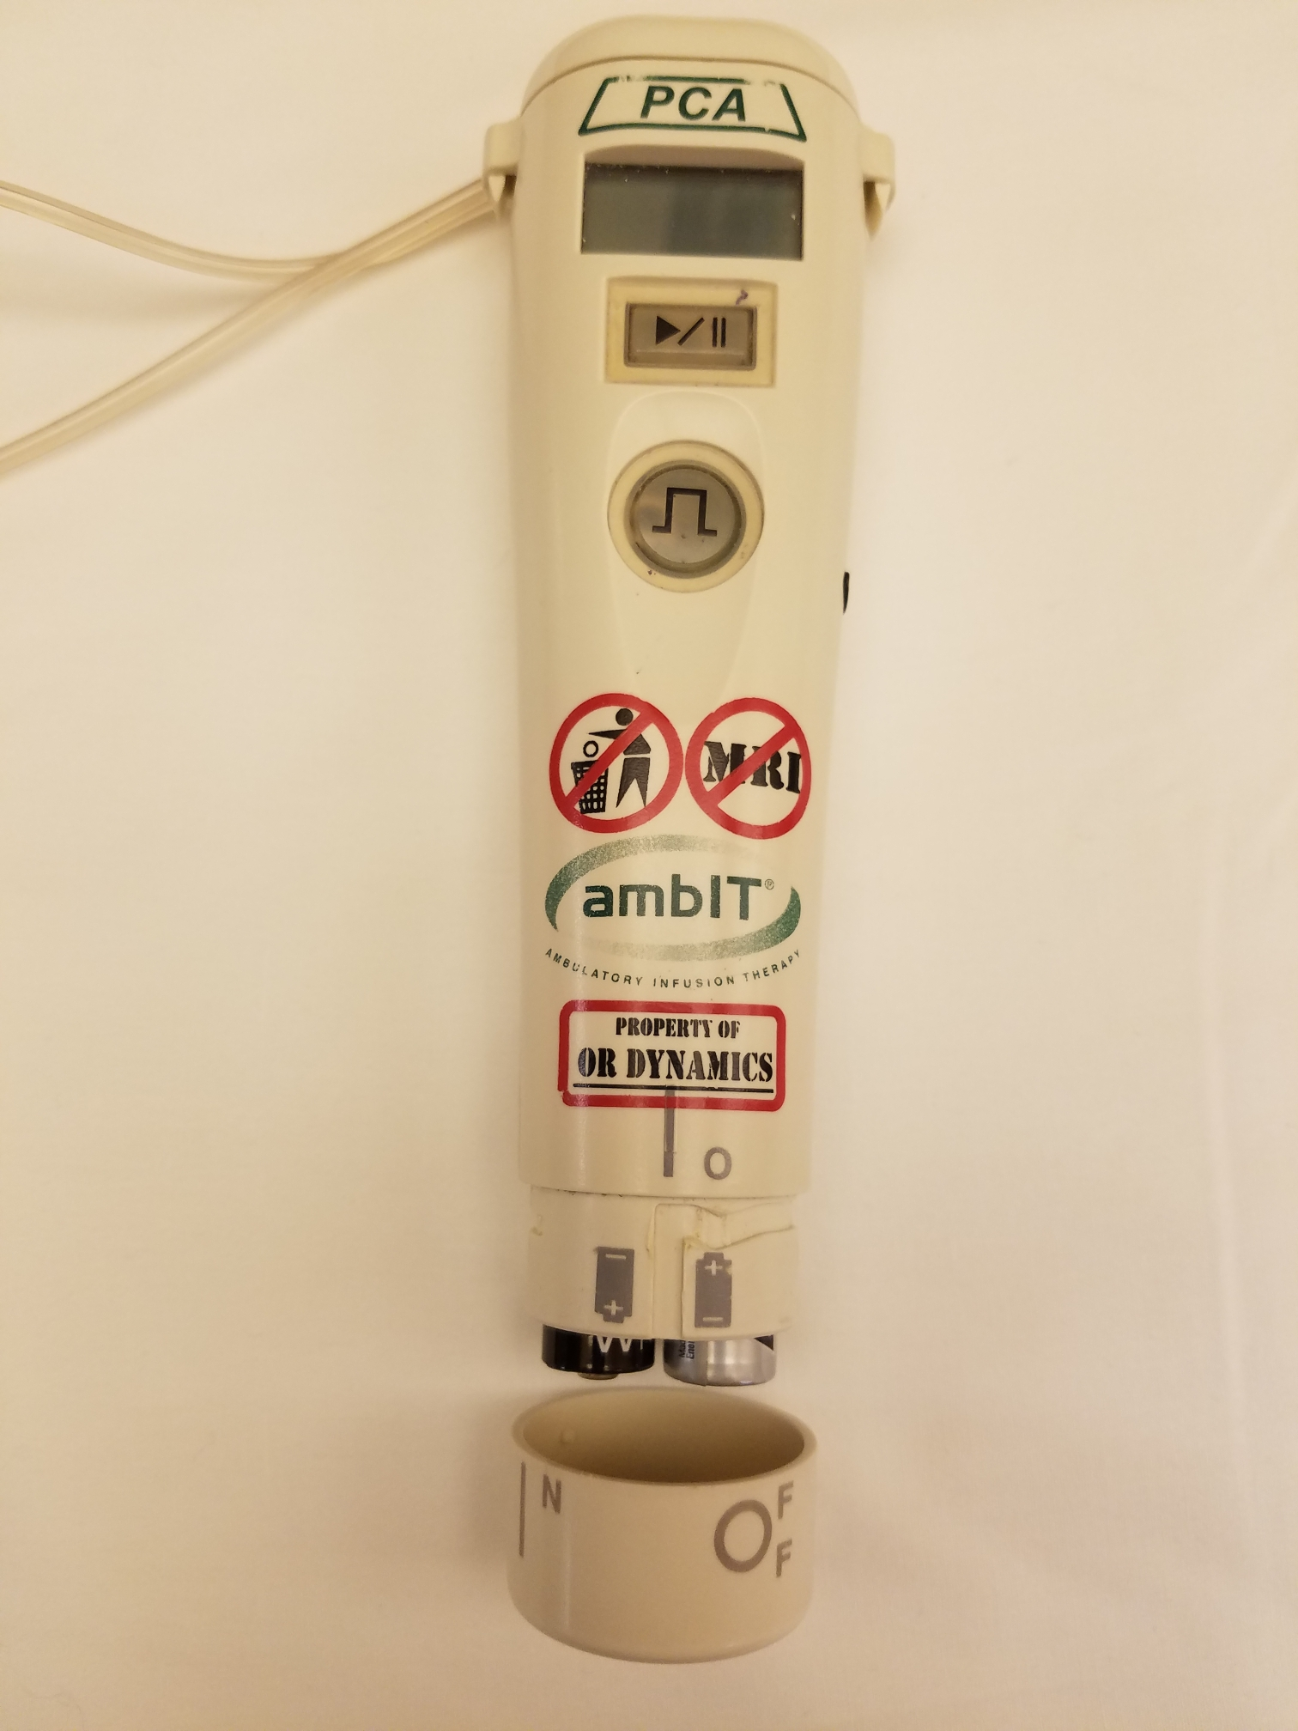
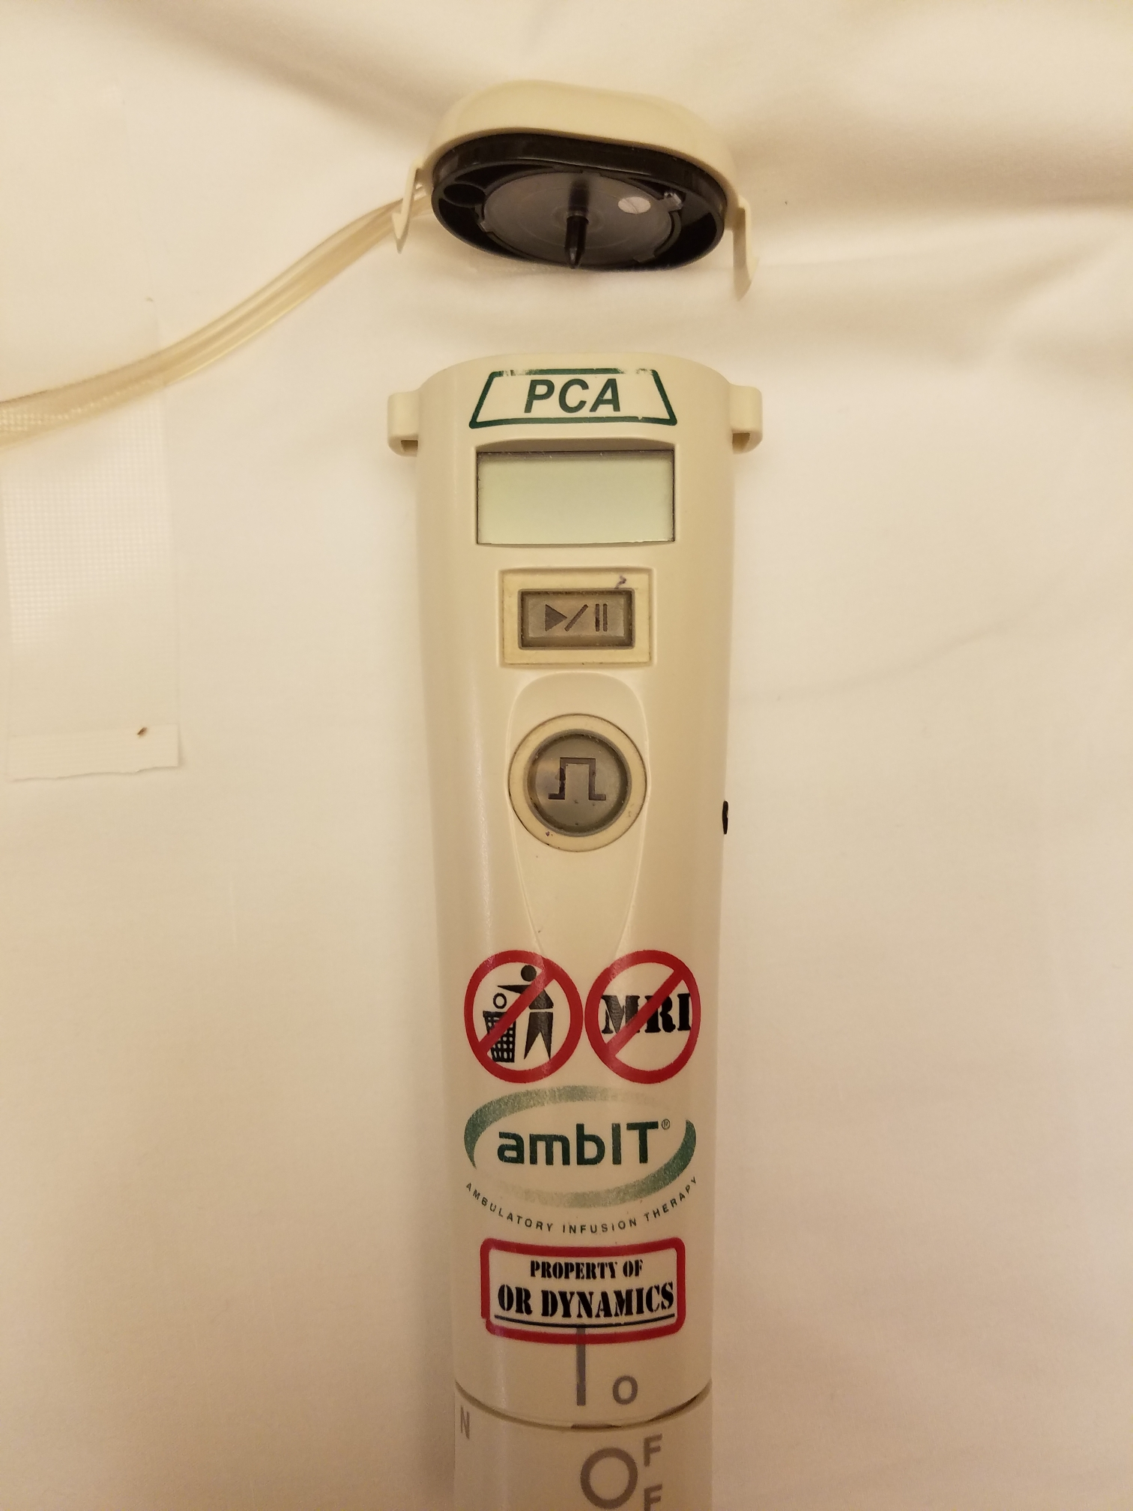
Preparing Your Pump to Return Via Mail (USPS):
Top Cassette
Clip
Send this portion of pump back in mailer
Battery cap

Slide 20
A Few Reminders About the Pump and Nerve Catheter:
No showering or bathing with the catheter and pump in place
Make sure to always carry the black bag with you while the pump is in place
It is OK to take your other prescribed pain medications while the pump is in place
Avoid direct contact with extreme temperatures
  Ice is OK to use if it is not directly on your skin and does not get the pump wet

Slide 21
A Few Reminders About the Pump and Nerve Catheter:
You will be discharged from the hospital with more detailed information about your nerve block.
This information will be in your After Visit Summary (AVS)
  It is very important you read this again once you get home after surgery.

Slide 22
Who to Contact After you Leave the Hospital:
The pump is supplied by OR Dynamics. If you have any questions about your pump please contact OR Dynamics 24-hour hotline at
877-620-6060.
If no return call in 5 – 10 mins call
888-343-7171
Contact OR Dynamics if you experience:
Unexpected alarm sounds
Any questions relating to the use of the pump
Any side effects from the pump medication

Slide 23
This completes the pre-surgery Nerve Block Catheter and Home Pain Pump education.
Thank you for your time.
We look forward to taking care of you!

