Slide 1
Total Joint Discharge Instructions
Molly Sieffert BSN, RN
Orthopedic Nurse Navigator

Slide 2
This information is a review of the content in your Hip/Knee Replacement Guide, that you received from your surgeon’s office, and was referred to in your pre-operative education class. Please keep the guidebook handy at home, for easy reference as you recover.
Please watch this presentation and ask your nurse if you have any questions.

Slide 3
Pain Management
Take Tylenol 1000 mg every 8 hours, and your opioid pain medication as needed
Side effects of the opioid pain medication are nausea, constipation and drowsiness
It is important you take your pain medication as prescribed
Having pain doesn’t mean you should stop your physical therapy
If your pain medicine isn’t effective in controlling your pain contact your surgeon

Slide 4
Swelling/Bruising
Swelling is normal and can continue for a few months after surgery
Bruising is also very common
Elevating your leg above the level of the heart is important
Make sure you are using cold therapy e.g. cold machine/gel packs to help reduce the swelling

Slide 5
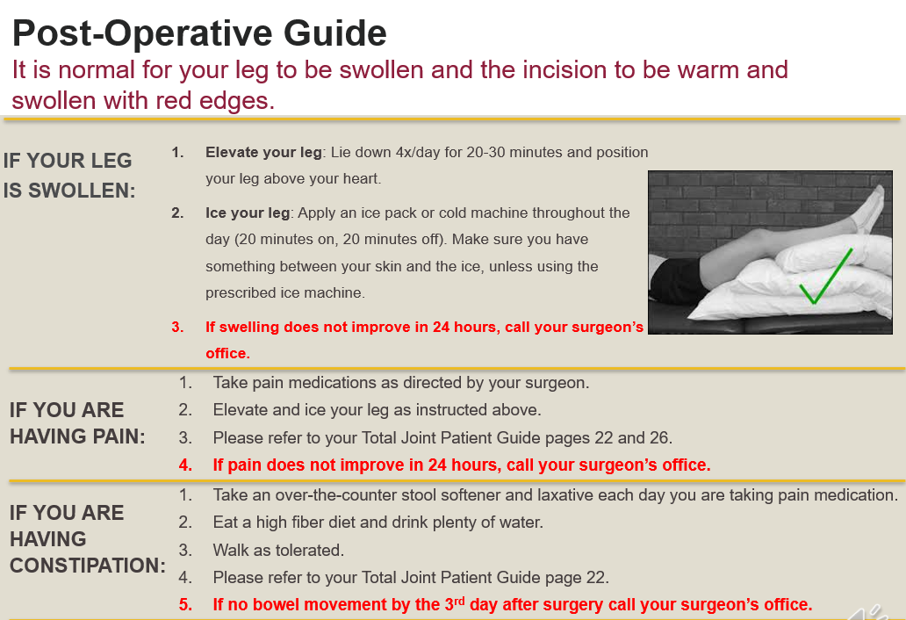

Slide 6
Constipation Prevention
To prevent constipation:
Increase your fluid intake and fiber in your diet
Increase your activity
Make sure you take a stool softener (Colace) and a laxative (Miralax)
Continue to take this medication until you are no longer taking an opioid for pain and having regular bowel movements

Slide 7
Nausea Prevention
You may experience nausea after your surgery due to the anesthesia, pain medication and constipation.
To prevent nausea:
Don’t take your pain medicine on an empty stomach.
Eat some type of food before taking the medication.
Eat small frequent meals and drink plenty of water
Contact your surgeon if you continue to have nausea with your pain medication.

Slide 8
Other common complaints after surgery
Frequent urination
Insomnia
Decreased appetite

Slide 9
Signs and Symptoms of a DVT
Signs of a DVT (blood clot in the leg) are:
Swelling in the thigh, calf or ankle that doesn’t go down after elevating your leg
You might also have unusual pain, heat or tenderness in calf, thigh, groin or back of the knee

Slide 10
Signs and symptoms of a PE
Signs of a PE (blood clot in the lungs) are:
Shortness of breath
Chest pain
Coughing up blood
Rapid heart rate
Confusion

Slide 11
Blood Clot Prevention
Ankle pump/circulation exercises
Get up for a short walk at least every hour
Take your anticoagulant medication as prescribed
  A possible side effect of anticoagulants is excessive bleeding, if you notice any severe or recurrent bleeding call 911
  You should also seek immediate medical attention if you
  Are involved in a major accident
  Experience a blow to the head
  Are unable to stop any bleeding

Slide 12
Incision Care
You should remove your dressing 7 days after surgery
You may shower with the dressing on and after it is removed
Do not put lotions or creams on your incision
Do not go in a tub bath, hot tub, pool or lake until your incision is completely healed

Slide 13
Infection Prevention
Do not touch your incision until it is healed
Do not put lotions, creams, ointments or sprays on your incision until it is well healed and scarred
If you develop a cut or puncture wound anywhere on your body, clean the area thoroughly. Watch carefully for redness, drainage, a fever or other signs of infection
Tell your primary care provider and your dentist that you have a joint replacement
Do not have a routine dental check-up or cleaning for at least 3 months following your joint replacement

Slide 14
Mobility /Exercises
Continue following your home exercise program given to you by your physical therapist. This is also in your Hip/Knee Replacement Guide
Get up for a short walk every hour
Your activity level should increase every day as you progress in your recovery, you may use a pedometer/activity tracker to track your steps

Slide 15
Contact your Orthopedic Surgeon if:
You have more than one temperature greater than 101 degrees in 24 hours or chills with a fever
You have bleeding from your incision that leaks out from your dressing
You have an increase in drainage or a bad smell from the incision
You develop an open area on incision
You are having pain that you can’t control when you are taking your pain medications as directed
You develop numbness or tingling in the surgical foot or leg

Slide 16
Contact your Orthopedic Surgeon if:
You fall
You develop any symptoms of a blood clot in your leg such as swelling in the thigh, calf or ankle that doesn’t go down after elevating your leg; or pain, heat or tenderness in calf, thigh, groin or back of the knee
Call 911 if you develop chest pain or sudden shortness of breath or any other symptoms of a blood clot in your lung

Slide 17
Thank you for your attention today. If you have any questions about this information, talk with your nurse.
The education is available at any time for you or your family to view and review again.
Thank you,
Molly
Orthopedic Nurse Navigator

