Slide 1
The Fundamentals of Phlebotomy
Kristin Jenkins

Slide 2
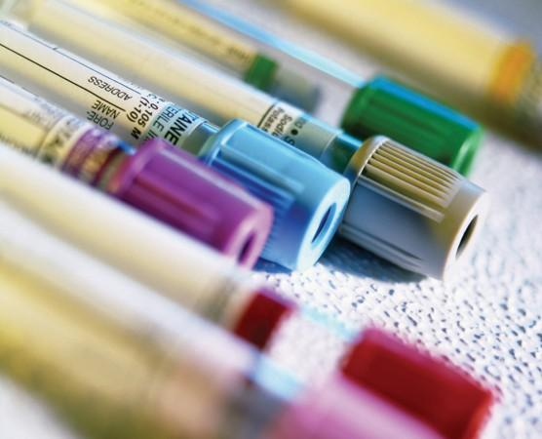
Terminology
Additive Tube - Blood collection tubes that contain a substance in the tubes that prevent or promote blood from clotting.
Clotting - When the blood in a tube forms a solid gel, instead of staying liquid.

Slide 3
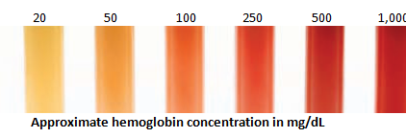
Terminology (continued)
Hemolysis - The Red Blood Cells (RBC) are torn apart, changing some test analyte concentrations, example increase in the potassium. Usually caused by forcing blood through small diameters or introduction of water or alcohol.
Inverting tubes - Slowly turning the tubes up and down.
Needle Bevel - Open end of needle.

Slide 4
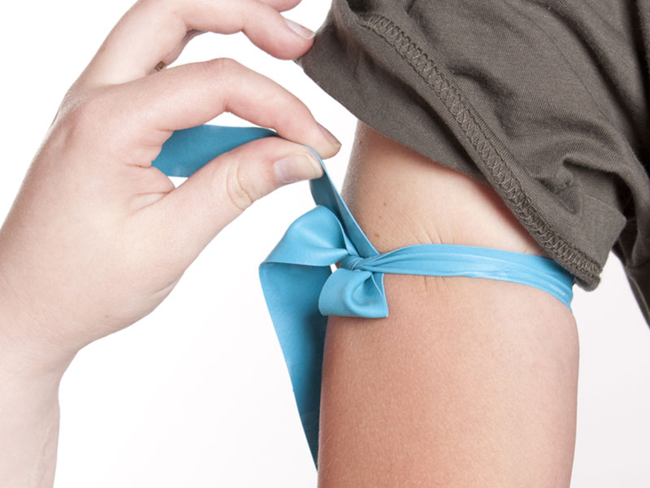
Terminology (continued)
Tourniquet - Elastic band used to create a barrier to blood flow, to assist in the blood collection process.
Vacutainer tubes - Blood collection tubes with vacuum to assist in pulling blood into the tube.

Slide 5
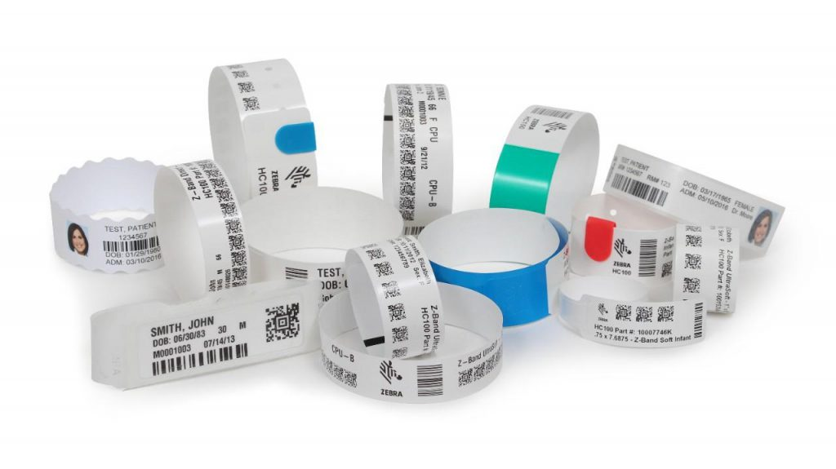
Patient Identification
JCAHO standards require that all patients are identified using the LAST NAME, FIRST NAME and DATE OF BIRTH.

Slide 6
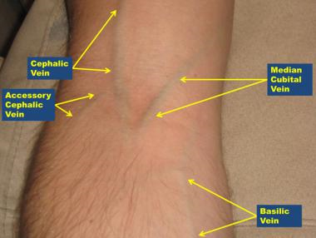
Vein Selection
Median Cubital vein – preferred, less likely to move on needle insertion, least painful to the patient.
Cephalic vein - acceptable
Basilic vein - more
painful for patient,
close proximity to
antebrachial
cutaneous nerve,
harder to get.

Slide 7
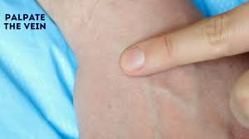
Vein Selection (continued)
Palpate and trace the path of veins with the index finger of your NON-DOMINANT hand.
Arteries pulsate, are most elastic, and have a thick wall
Scar tissue- go above or below, may be difficult to poke through

Slide 8

Tying the Tourniquet
Apply the tourniquet 3-4 inches above the selected puncture site. (The patient should make a fist without pumping the hand)
Select the venipuncture site.
The tourniquet should be tight enough to increase blood pressure in the veins; but not so tight that it cuts off circulation.
Tie so that you can remove with one hand, after good blood flow is established and before final tube is filled.
Never leave on for more than
1 minute.

Slide 9
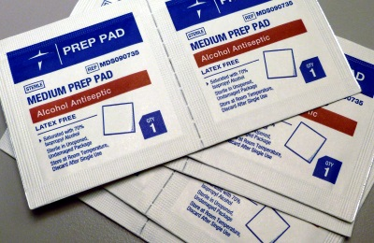
CLEANSING THE VENIPUNCTURE SITE
Cleanse with 70% Isopropyl alcohol, use iodine without alcohol for ethanol test.
Concentric circles are outdated.
Must be allowed to dry.
Air dry
Residual alcohol will cause discomfort to the patient and will result in hemolysis.
Once the site is cleansed, it must not be touched!

Slide 10
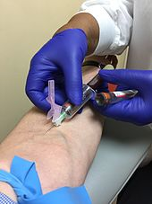
Performing the Venipuncture
If you are right handed hold the hub and needle with that hand.
All other “tasks” during the draw will be done with your other hand.
Grasp the patient's arm firmly using your thumb to draw the skin taut and anchor the vein.
Bevel up.
The needle should form a 15 to 30 degree angle with the surface of the arm.
Swiftly insert the needle through the skin
and into the lumen of the vein.

Slide 11
Performing the Venipuncture (continued)
Avoid trauma and excessive probing
If no blood is forthcoming, slight manipulation of the needle is appropriate
Engage the first tube into the hub
Allow the tube to fill completely
While holding the needle and hub steady remove the first tube and engage the next following the order of draw.
It is important to keep your eye on the needle and your patient during the draw.

Slide 12
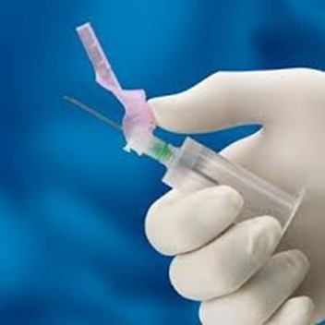
Removing the Needle
Ensure that the tourniquet is released and last tube is filled
Remove needle in a swift backward motion and engage the safety device
Press down on the gauze once the needle is out of the arm, applying adequate pressure to avoid formation of a hematoma
Dispose of needle in sharps container
Apply pressure, keeping arm straight
Apply appropriate dressing

Slide 13
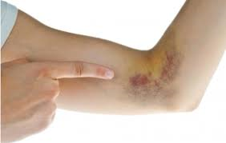
Potential Complications
Hematoma
Needle not correctly positioned in vein
Moving the needle in and out of the vein
Damage to vein wall, blood leaking around inserted needle under skin
Removing the tourniquet after the removing the needle
Not providing pressure for enough time to puncture site after removing needle

Slide 14
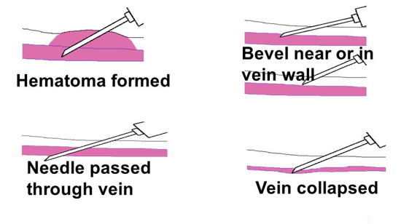
Potential Complications (continued)
Short draws:
Needle moved out of the vein or attached to the vein wall

Slide 15
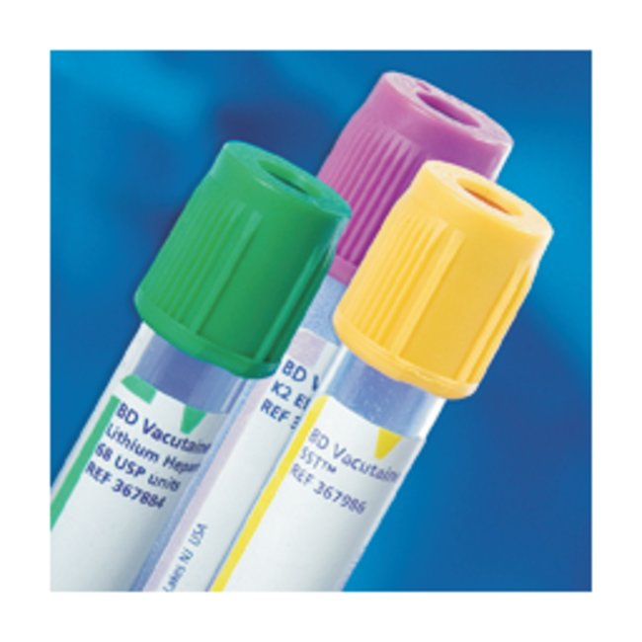
Tubes and Additives
Two categories of tubes:
Clot Activators - contain silica/gel to promote clotting for tests ran on serum
Anticoagulants – prevent clotting on specimens ran on whole blood or plasma

Slide 16
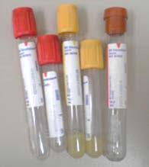
Types of Tubes—Clot Activators
Red Top Tube
Used for some drug levels and reference testing
Gold Top Tube (Serum Separator Tubes/SST)
PSAs and reference testing
Note: Invert to speed up clotting, and after centrifuged the serum is separated from the cells by the barrier gel.

Slide 17
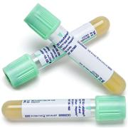
Types of Tubes—Anticoagulants
Lavender top tubes (EDTA)
BNP, CBC, Differentials, Sed Rate
Blue top tubes (Citrate) – must be filled to the clear line
Protimes, APTT’s
Light Green top tubes (Lithium heparin)
CMP, BMP, Glucose, HFP and \
Cardiac markers -Troponin, CK-MB

Slide 18
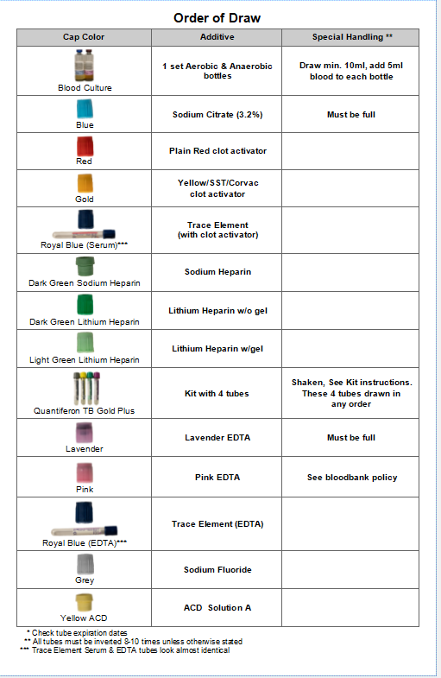
Order of Draw

Slide 19
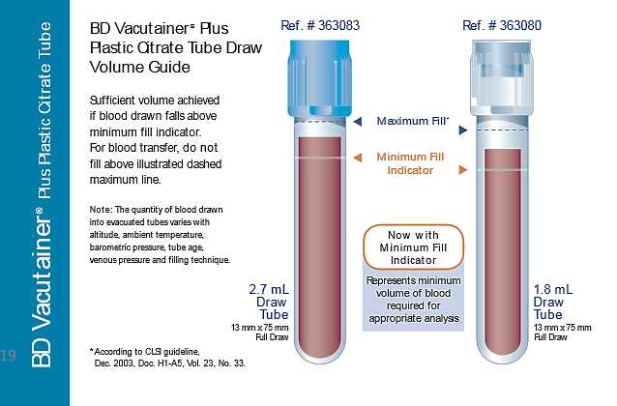
DRAWING SPECIMENS FOR COAG TESTING
Tube must be full
Invert gently to prevent clots
No hemolysis
Must be received at the lab within 4 hours

Slide 20
Blood Draw Procedure
Hand Hygiene
ID patient
Apply tourniquet
Find site
Cleanse site
Anchor vein
Insert needle
Pop on tube
Allow tube to fill/make adjustments if needed
Remove tourniquet
Remove tube
Remove needle
SAFETY DEVICE!!
Apply pressure
Invert tubes
Label Specimen at the patient’s side

Slide 21
Questions?
Contact the Phlebotomy Educator
Kristin Jenkins 616-685-6029
Contact the Laboratory 24 hours a day
Saint Mary’s Main Laboratory 616-685-6248

